Slide 1
Numerical Integration 3: Adaptive Quadrature
AMSC/CMSC 460
Dr. Christopher Moakler

Slide 2
Are Equally Spaced points the best?
We’ve looked at methods so far that rely on equally spaced data points.
That is, we have divided up the interval of interest into equally spaced subintervals.
This makes it very easy to implement since we just throw in factors of ½ .
However, sometimes we may run into issues with equally spaced.
Why?

Slide 3
An example of a function with a varying derivative
Hoffman

Slide 4
An example of a function with a varying derivative
Sauer

Slide 5
Benefits of uneven sampling
Sometimes we have functions with regions that change rapidly and other regions where the change is very slow.
For the regions that vary a lot, we need to use many subintervals.
For the slowly varying regions, we can get away with using fewer subintervals.
However, the methods we have already looked at require the intervals to all be of the same width.
How can we get around this?
More importantly, how can we do this automatically with little to no user input?

Slide 6
“Quadrature”
Before I forget, quadrature is just a fancy term for integration.
It comes from Ancient Greek mathematicians who found the areas of figures by drawing a square with the same area.
This, to them, was the only way to speak of the area of a figure.
It’s interesting to think of math through the lens of mathematicians who came before us.

Slide 7
A barely related tangent
These people were no less intelligent than we are, but they lacked the formalism and notational conveniences we have that allow us to do much more robust mathematics.
Some people like to think of mathematics as just numbers on a page.
This is certainly not true.
Others think of it as the application of formal logic with certain axioms.
I am certainly partly in this camp.
But we shouldn’t forget that math was done for centuries with just a compass and straightedge.
It’s sometimes useful to go back to this if only to get a sense of what math was, and maybe give us insight into what it might become.

Slide 8
Using the error
Where were we?
Oh yes!
How can we automatically divide an interval into smaller subintervals when the function is quickly varying in that interval?
We can look at the error term in the approximations we make and, if the error is too large, we break that interval up into more subintervals.
However, we can’t typically directly compute this error term.
Why not?
The error term generally requires a high order derivative that we probably don’t have access to.

Slide 9
Analyzing the error
Let’s look at the Trapezoid rule,
$$\int_{a}^{b}{f(x)}dx=I_{\left[a,b\right]}−h^{3}\frac{f′′(c_{0})}{12}$$
If we break the interval up at the midpoint, c, we get
$$\int_{a}^{b}{f(x)}dx=I_{\left[a,c\right]}−\frac{h^{3}}{8}\frac{f′′(c_{1})}{12}+I_{\left[c,b\right]}−\frac{h^{3}}{8}\frac{f′′(c_{2})}{12}$$
$$\int_{a}^{b}{f(x)}dx=I_{\left[a,c\right]}+I_{\left[c,b\right]}−\frac{h^{3}}{4}\frac{f^{′′}\left(c_{3}\right)}{12}$$
where $c_{1} ε [a,c]$ and $c_{2} ε [c,b]$

Slide 10
Analyzing the error cont
Let’s compare the approximate integrals,
$$I_{\left[a,b\right]}−\left(I_{\left[a,c\right]}+I_{\left[c,b\right]}\right)={−h}^{3}\frac{f^{′′}\left(c_{0}\right)}{12}+\frac{h^{3}}{4}\frac{f^{′′}\left(c_{3}\right)}{12}$$
If we approximate $f^{′′}\left(c_{0}\right)≈f^{′′}\left(c_{3}\right)$ since we assume the intervals become small, we get,
$I_{\left[a,b\right]}−\left(I_{\left[a,c\right]}+I_{\left[c,b\right]}\right)≈3\frac{h^{3}}{4}\frac{f^{′′}\left(c_{3}\right)}{12}$.
We can now approximate the error based on only things we can compute!
Using this we can set up a criterion to decide whether to further subdivide.
If the new approximation is “close enough” to the old approximation, we can stop.
If not, we further subdivide.

Slide 11
Adaptive Quadrature Algorithm
$$c=\frac{a+b}{2}$$
$$I_{\left[a,b\right]}=\left(b−a\right)\frac{f\left(a\right)+f(b)}{2}$$
$$if abs\left(I_{\left[a,b\right]}−I_{\left[a,c\right]}−I_{\left[c,b\right]}\right)<3∗TOL\left(\frac{b−a}{b_{0}−a_{0}}\right)$$
$approx=I_{\left[a,c\right]}−I_{\left[c,b\right]} \%accept the approximation over this interval$
$$else$$
$halve the regions \left[a,c\right] and \left[c,b\right] recursively$
$$end$$

Slide 12
Adaptive Quadrature using Simpson’s Rule
We can do a similar analysis using Simpson’s 1/3 Rule.
In that case we get an error rejection criterion of
$$abs\left(I_{\left[a,b\right]}−I_{\left[a,c\right]}−I_{\left[c,b\right]}\right)<15∗TOL$$
It is typical to replace 15 by 10 to get a tighter bound.
Thus, we have
$$abs\left(I_{\left[a,b\right]}−I_{\left[a,c\right]}−I_{\left[c,b\right]}\right)<10∗TOL$$

Slide 13
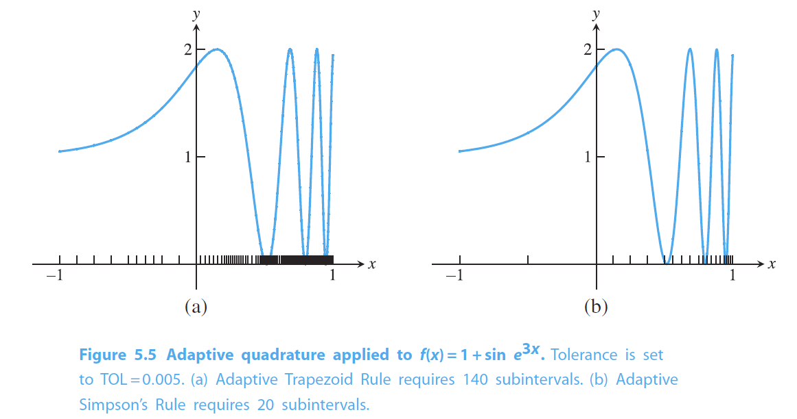
Adaptive Quadrature Example
Sauer

Slide 14
Orthogonal Functions
Before our next topic, a brief foray into orthogonal functions.
We’re all familiar with the idea of orthogonality.
That is two things that are $90°$ from one another.
We are well familiar with orthonormal vectors.
Vectors such that $\overline{v_{i}}∙\overline{v_{j} }=0$ and $\left|v_{i}\right|=1$
This can be extended to functions as well.
The continuous analog to an inner (dot) product is an integral.
Thus, two functions are orthogonal on the interval $[a,b]$if
$$\int_{a}^{b}{p_{i}\left(x\right)p_{j}\left(x\right)}dx \left\{\begin{aligned}=0 if i≠j \\ ≠0 if i=j\end{aligned}\right.$$

Slide 15
Orthogonal Function Examples
Let’s find a set of orthogonal polynomials on the interval [-1,1].
Starting with $p_{0}=1$ seems like a reasonable start.
Moving on to $p_{1}=x$ seems like another good step.
Let’s check that guess,
$$\int_{−1}^{1}{1⋅x}dx=0.$$
Great!
Let’s see if it continues with $p_{2}=x^{2}$
$$\int_{−1}^{1}{1⋅x^{2}}dx=\frac{2}{3}$$
No dice…

Slide 16
Orthogonal Function Example Contd
If we change our $p_{2}$ to be $x^{2}+C$ we can get,
$$\int_{−1}^{1}{1⋅{(x}^{2}+C)}dx=\frac{2}{3}+2C$$
If we have $C=−\frac{1}{3}$, we do in fact get a set of orthogonal functions.
Let’s check the last pair,
$$\int_{−1}^{1}{x⋅{(x}^{2}−\frac{1}{3})}dx=x^{3}−\frac{1}{3}x{\left.​\right|}_{−1}^{1}=0$$
So, these polynomials form an orthogonal set,
$p_{0}=1$, $p_{1}=x$, and $p_{2}=x^{2}−\frac{1}{3}.$
These polynomials were also found by Legendre.

Slide 17
Legendre Polynomials
The Legendre Polynomials form an orthogonal set polynomials on the interval $\left[−1,1\right]$.
The Legendre Polynomials are given by,
$$p_{i}\left(x\right)=\frac{1}{2^{i}i!}\frac{d^{i}}{dx^{i}}\left({\left(x^{2}−1\right)}^{i}\right)$$
Matlab has built in functions to get the Legendre Polynomials of various degrees.

Slide 18
Basis Functions
We can use these orthogonal functions to form a basis.
In particular, if we have a set of orthogonal polynomials, we can use them to form a basis for all polynomials on an interval.
To be more precise, if we have a collection of orthogonal polynomials $\{p_{0}, p_{1}, p_{2}, …,p_{n}\}$ on the interval $[a,b]$ where the subscript denotes the degree of the polynomial, these form a basis for all polynomials of at most $n$degree.
I’m omitting the proof of this theorem.
Another theorem we’ll need is that if we have a set of orthogonal polynomials on the interval $\left[a,b\right]$, then the $p_{i}$ polynomial has $i$ distinct roots on the interval $\left[a,b\right].$
I’m also omitting this proof.

Slide 19
Gaussian Quadrature
We can use these Legendre Polynomials to approximate the integral of a function.
More specifically, we use the ROOTS of the Legendre Polynomials.
The details are a bit more involved than we need, but all we need to know is that,
$$\int_{−1}^{1}{f(x)}dx≈\sum_{i=1}^{n}{w_{i}}f\left(x_{i}\right)$$
where $w_{i}=\int_{−1}^{1}{L_{i}\left(x\right)}dx$ and the $x_{i}$ are the roots of Legendre Polynomial.

Slide 20
Gaussian Quadrature Tables
https://en.wikipedia.org/wiki/Gaussian_quadrature

Slide 21
Change of Interval
Gaussian Quadrature as written before only applies to the interval $\left[−1,1\right]$.
However, we often want to find integrals over other intervals!
We can modify our previous method with a simple substitution,
$$s=\frac{\left(2x −a−b\right)}{b−a}$$
This gives us the general form,
$$\int_{a}^{b}{f(x)}dx=\int_{−1}^{1}{f\left(\frac{\left(b−a\right)s+b+a}{2}\right)\frac{b−a}{2}}ds$$

Slide 22
Gaussian Quadrature Benefits
Gaussian Quadrature approximates the integral of a function accurately by carefully picking where to sample the function.
This is very similar to Chebyshev Nodes from polynomial interpolation.
The Newton Cotes methods that we looked at before use $\left(n+1\right)$ function evaluations to get a degree of precision of $n.$
Or $\left(n+1\right)$ if n is even.
Gaussian Quadrature has a degree of precision of $\left(2n+1\right)$ for $\left(n+1\right)$ function evaluations!
Remember this means that a polynomial of degree $\left(2n+1\right)$ is integrated exactly by this method.
So, if we can approximate our function by a polynomial of degree $\left(2n+1\right)$, we can get a good determination of the integral!

Slide 23
Extensions
These methods can be extended to multidimensional functions in a relatively straightforward way.
Think Fubini’s Theorem.
You can approximate a function with parallelepipeds and break the region of integration into a grid.
However, the typical approach you see for higher dimensional quadrature uses Monte Carlo Integration.
The basic idea of MC Integration is to randomly sample the region of interest and use the Mean Value theorem to estimate the integral.
$$\int_{a}^{b}{f(x)}dx≈\frac{b−a}{N}\sum_{i=1}^{N}{f\left(x_{i}\right)}$$

